Slide 1
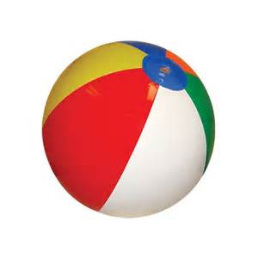
Evaluation only.
Created with Aspose.Slides for .NET 4.0 Client Profile 16.4.0.0.
Copyright 2004-2016Aspose Pty Ltd.

